Slide 1
Statistical Foundations and Modern Methods in Machine Learning
Prof. Dr. Tanvir Ahmad

Slide 2
Abstract
Machine Learning is deeply rooted in statistical inference.
This talk explores how classical statistics underpin modern ML methods.
We discuss estimation, hypothesis testing, probabilistic modeling, and interpretability.
Real-world examples show the synergy between statistics and computational learning.

Slide 3
Key Themes Overview
1. Statistical Roots of Machine Learning
2. Probabilistic Modeling and Inference
3. Multivariate and High-Dimensional Challenges
4. Modern Learning Paradigms
5. Interpretability and Fairness
6. Toward a Unified Framework

Slide 4
Statistical Roots of Machine Learning
From regression and discriminant analysis to supervised learning.
Bias–variance tradeoff and overfitting: statistical interpretation.
The role of statistical inference in generalization.

Slide 5
Probabilistic Modeling and Inference
Likelihood, Bayesian inference, and uncertainty quantification.
Latent variables and the EM algorithm.
Probabilistic thinking in model evaluation.

Slide 6
Multivariate and High-Dimensional Challenges
Curse of dimensionality and regularization (Lasso, Ridge).
Dimensionality reduction: PCA, manifold learning, and autoencoders.
Handling correlated features and multicollinearity.

Slide 7
Modern Learning Paradigms
Ensemble methods: Bagging, Boosting, Random Forests.
Deep learning architectures: statistical interpretation.
Probabilistic graphical models and Gaussian processes.

Slide 8
Interpretability and Fairness
Statistical interpretability vs. algorithmic opacity.
Confidence intervals and model calibration.
Explainable AI (XAI) and responsible learning.

Slide 9
Toward a Unified Framework
Bridging theory with scalable computation.
Integrating probabilistic reasoning in ML pipelines.
The future of statistically principled machine intelligence.

Slide 10
Audience and Duration
Intended Audience: Researchers, Data Scientists, Statisticians.
Duration: 30–40 minutes talk + 10 minutes Q&A.
Includes demonstrations and real-world case studies.

Slide 11
Closing Remarks
Statistics and Machine Learning are not separate disciplines — they are complementary.
Statistical thinking enhances interpretability, robustness, and trust in AI.
Thank you for your attention!

Slide 12
Practical Demonstrations and Real-World Case Studies
• Healthcare Analytics: Predicting disease outcomes using regression and random forests.
• Business Forecasting: Sales prediction using ensemble learning and PCA.
• Environmental Data Modeling: Air quality prediction from multivariate sensor data.
• The visual below illustrates a real-world data analysis workflow.

Slide 13
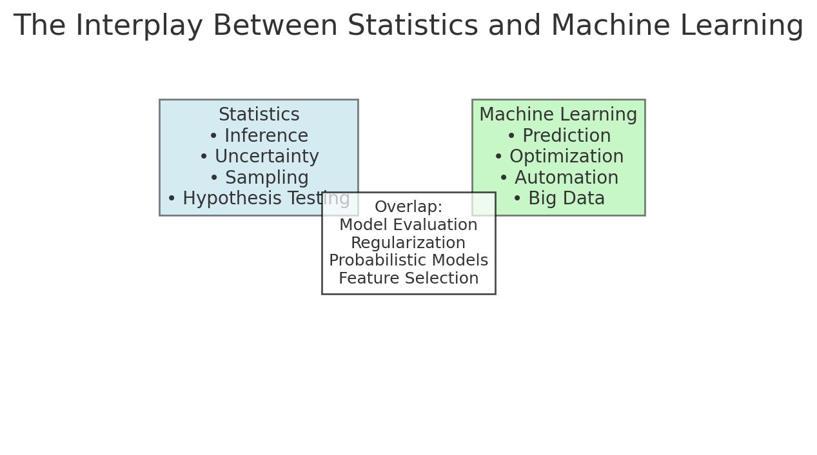
The Interplay Between Statistics and Machine Learning
Overlap of statistical inference and predictive modeling in modern data science.

Slide 14
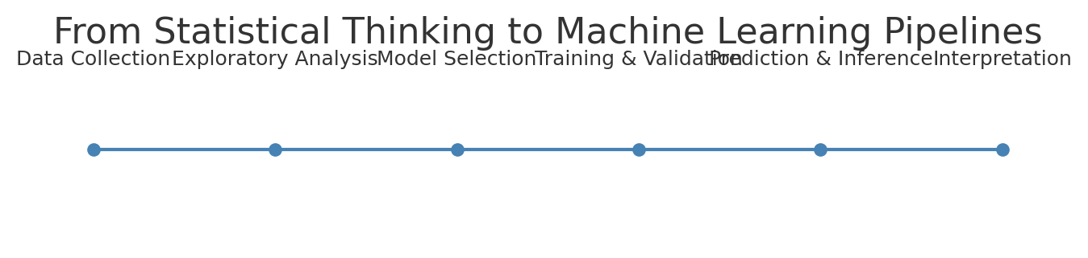
From Statistical Thinking to Machine Learning Pipelines
Sequential process from data exploration to inference and interpretation.

Slide 15
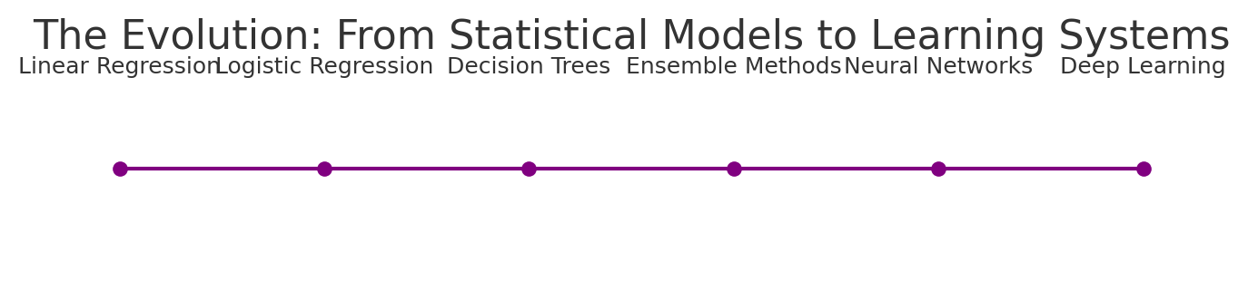
The Evolution: From Statistical Models to Learning Systems
The continuum from classical statistical models to deep learning systems.

Slide 16
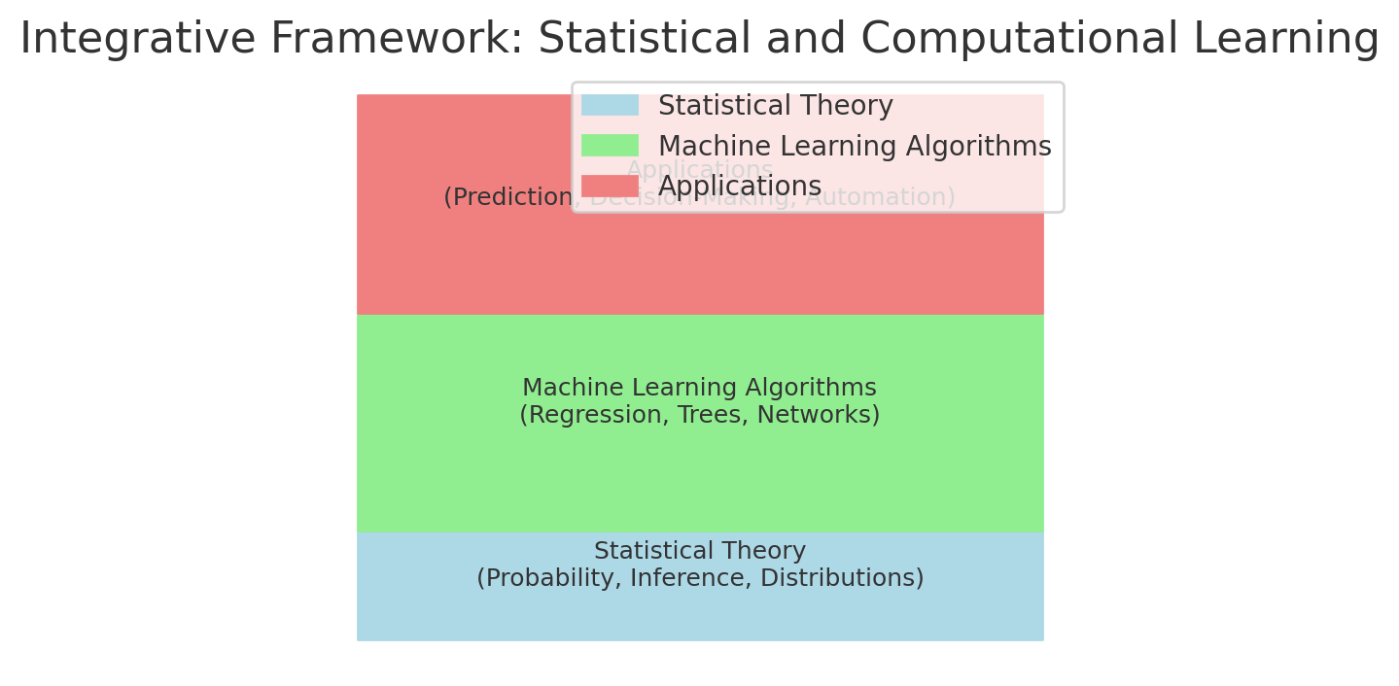
Integrative Framework: Statistical and Computational Learning
A unified view linking theory, algorithms, and real-world applications.

